Slide 1

Organizational Communication and Channels of Communication
Department of EFL

Slide 2
Organizational Communication
sending and receiving of messages among interrelated individuals within a particular environment or setting to achieve individual and common goals.
highly contextual and culturally dependent
Types: Internal, External, Formal, and Informal

Slide 3
Internal
External
Planned communications following the company’s chain of command among people inside the organization – e-mail, memos, conference calls, reports, presentations, executive blogs
Planned communication with people outside the organization – letters, instant messages, reports, speeches, news releases, advertising, websites, executive blogs
Formal
Casual communications among employees that do not follow the company’s chain of command – email, instant messages, phone calls, face-to-face conversations, team blogs
Casual communication with outsiders (e.g., suppliers, customers and investors) email, instant messages, phone calls, face-to-face conversations, customer support blogs
Informal

Slide 4
Channels of Communication
Channels of Communication
Formal
Informal
Upward
Downward
Horizontal
Diagonal/
Grapevine

Slide 5
Upward Communication
Starts from the lower levels and goes up to the higher level
Branch Manager
Finance Manager
Cashier

Slide 6
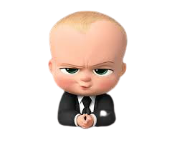


NO!
Superior
Sir… Students are proposing for dress code liberty. Your response…?!
Class Incharge
Can’t we have dress code freedom…?!
Student
(CR)

Slide 7
Downward Communication
Follows the hierarchical order from the higher to the lower level
Branch Manager
Finance Manager
Cashier

Slide 8
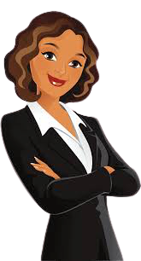


Let’s students have a day off for Onam festival!
Superior
Tomorrow will be a holiday to celebrate Onam!!!
Class Incharge
Hurray!!!
Students

Slide 9
Horizontal Communication
Takes place between employees of equal ranks/ peer groups
Finance Manager
Marketing Manager
Officer
Cashier
Customer
Customer

Slide 10

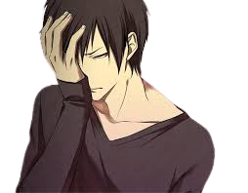


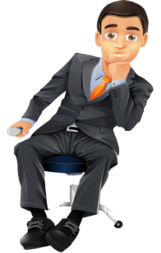

RESULT ANALYSIS (not up to the level)
48/50
23+2/50
I lost two marks
I gained two marks
Students
‘P’
‘P’
I’m going to resign!!
Class Incharges
I’ll be terminated!!!
Hereafter, I should be strict!
Superiors
I thought, I should have been lenient!!!

Slide 11
Diagonal/Grapevine Communication
Happens across all official cadres without hierarchical order – very effective
Management Company 1
Management Company 2
Financial Management
Financial Department
Production
Technical Department
Team Leader
Team Leader
Employee 1
Employee 2
Employee 1
Employee 2

Slide 12







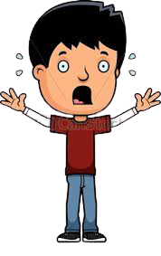
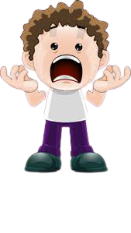


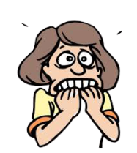


UNEXPECTED FIRE ACCIDENT
Superior
Teacher
Teacher
Student
Student
Student
Student
Security
Security
Maid
Maid

Slide 13


